Slide 1
2023 Budget Review
Budget Workshop #2:
October 13, 2022

Slide 2
Meeting Agenda/Guide

Slide 3
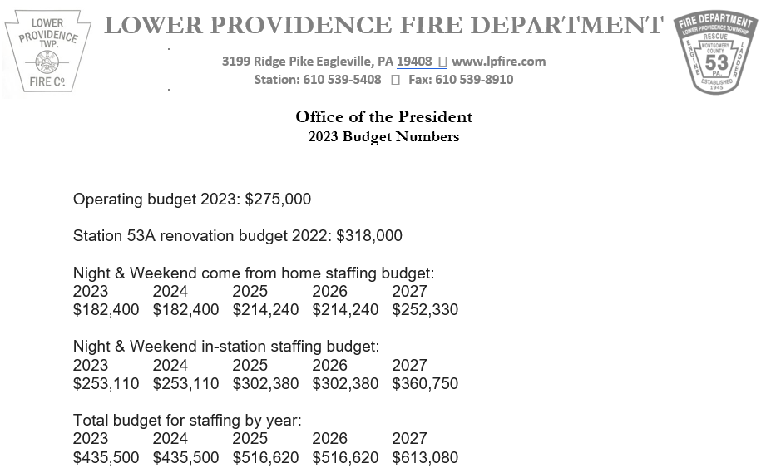
Fire Dept. 2023 Budget Request

Slide 4
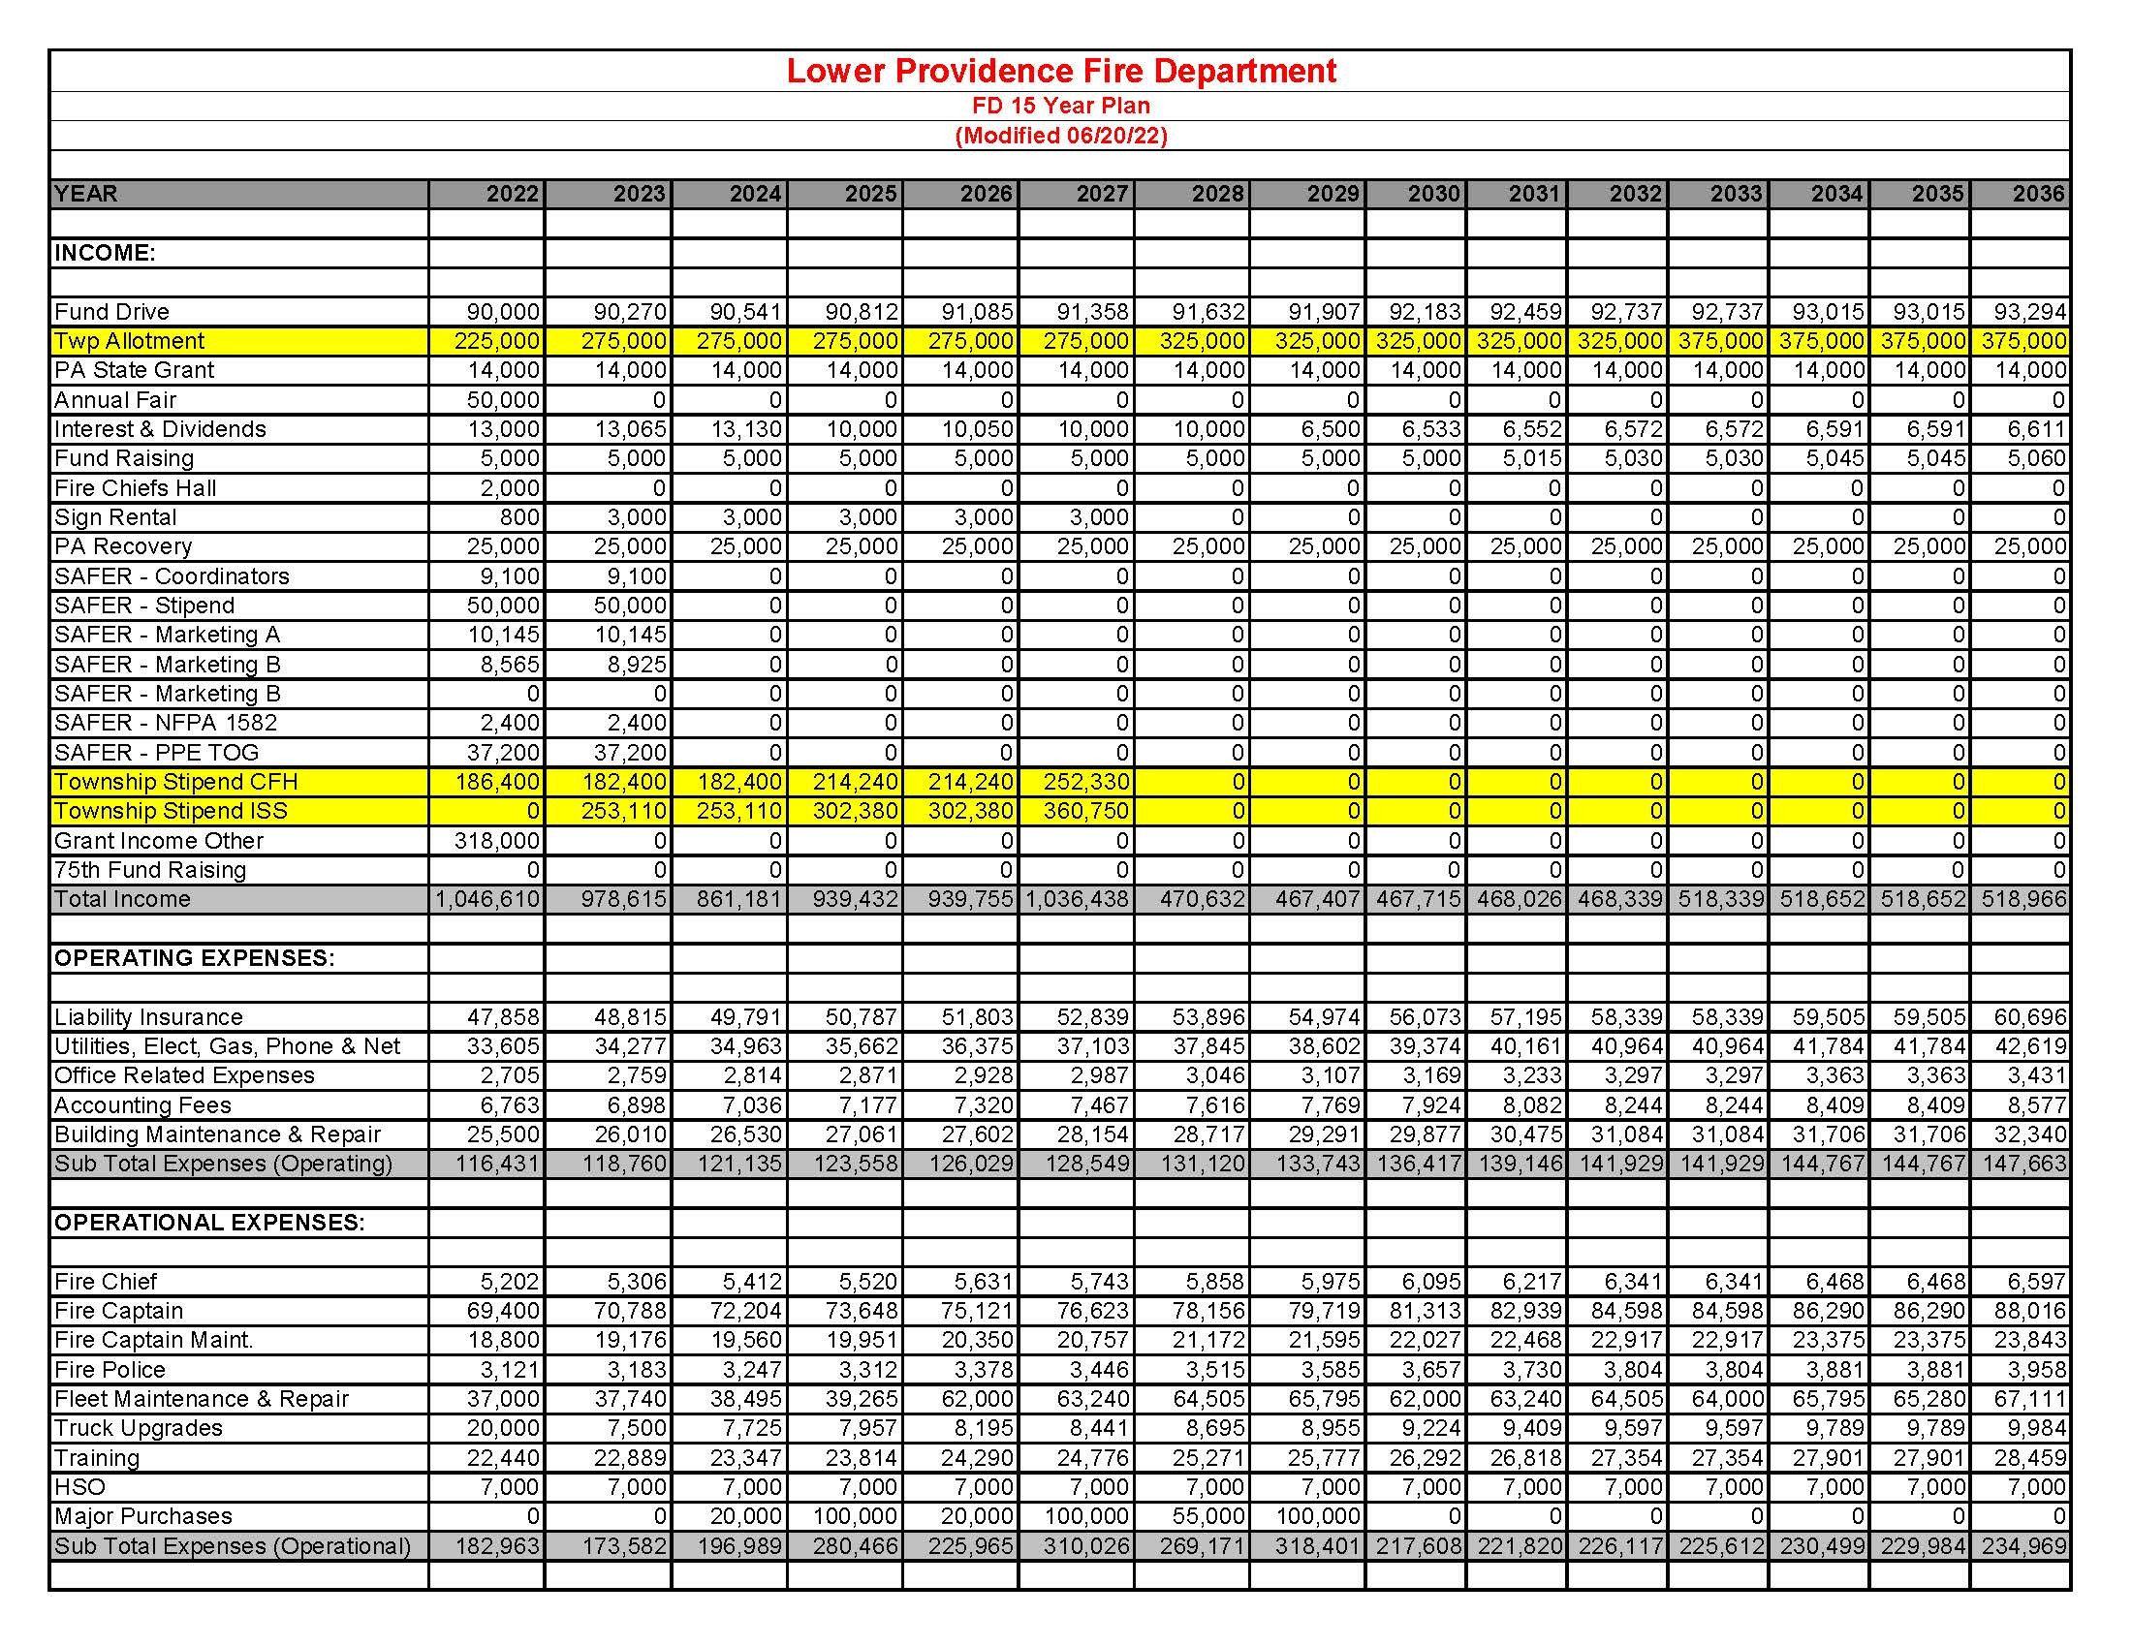
Fire Dept. 15-Year Plan (page 1)

Slide 5
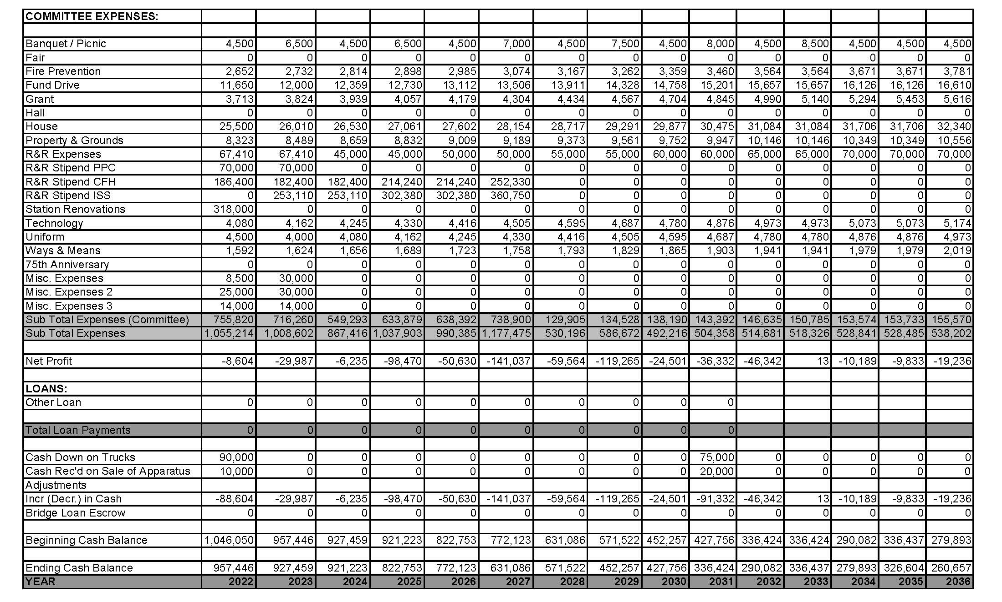
Fire Dept. 15-Year Plan (page 2)

Slide 6
LPEMS 2023 Budget Request
The budget as currently presented does NOT include increases to EMS funding or any ARPA allocation for EMS.

Slide 7
Lower Providence Township 2023 Budget
Operating Budget Review/Revisions
BOS questions/discussion
  Staffing changes
  Benefits Update – Healthcare renewals approximately $40,000 LESS than projected
  Fee schedule changes (business licenses, plumbing permits, Park & Rec fees)
  Other operational increases

Slide 8
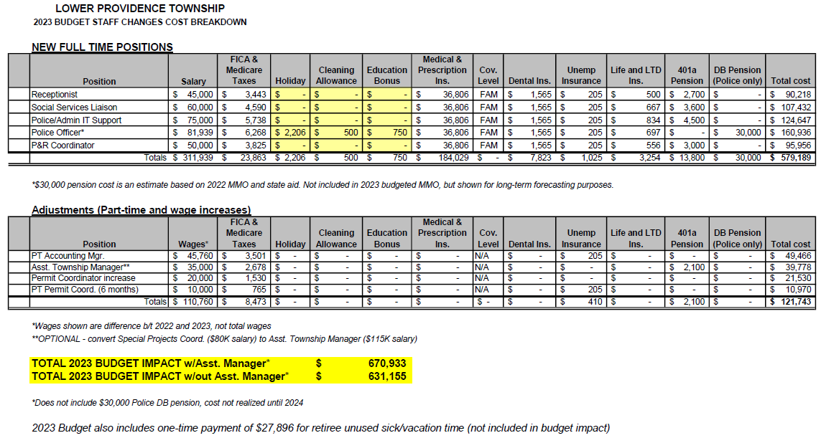
LOWER PROVIDENCE TOWNSHIP 2023 BUDGET
Proposed Staff Changes Budget Impact
Does not include wage/salary increases for current employees

Slide 9
2023 Capital Budget Requests (Prioritized)

Slide 10
LOWER PROVIDENCE TOWNSHIP 2023 BUDGET
ARPA Suggested Projects/Expenditures

Slide 11
Lower Providence Township 2023 Budget
Deficit Reduction Options
Current projected deficit = $1,191,685
  Expense Reductions
    Operating budget cuts
    Capital budget cuts
    Fire/EMS budget cuts
  Revenue Increases
    Fund balance utilization (including 2022 surplus carryover)
    Debt service millage reassignment
    Tax increases

Slide 12
Lower Providence Township 2023 Budget
FUND BALANCE SUMMARY
 |  |  | 2023 |  |  | 2023 |  | Fund balance
Fund |  |  | Beginning* | Revenue** | Expenditures | Ending |  | Change
01 |  | General Fund *** | $ 5,702,111.07 | $ 12,113,662.00 | $ 13,305,347.00 | $ 4,510,426.07 |  | $ (1,191,685.00)
03 |  | Emergency Services | $ 33,970.00 | $ 1,233,819.00 | $ 1,267,789.00 | $ - |  | $ (33,970.00)
04 |  | Library | $ - | $ 590,580.00 | $ 590,580.00 | $ - |  | $ -
18 |  | Traffic Impact | $ 2,569,147.00 | $ - | $ - | $ 2,569,147.00 |  | $ -
20 |  | Debt Service | $ 141,824.00 | $ 457,462.00 | $ 401,702.00 | $ 197,584.00 |  | $ 55,760.00
21 |  | LF Funded Loans | $ 772.00 | $ 178,336.00 | $ 179,108.00 | $ - |  | $ (772.00)
30 |  | Capital Projects | $ 26,006.00 | $ 1,396,751.00 | $ 1,422,757.00 | $ - |  | $ (26,006.00)
31 |  | P&R Operating | $ 147,341.00 | $ 897,180.00 | $ 1,013,032.00 | $ 31,489.00 |  | $ (115,852.00)
33 |  | P&R Capital | $ 357,695.00 | $ 121,002.00 | $ 156,922.00 | $ 321,775.00 |  | $ (35,920.00)
35 |  | Liquid Fuels | $ 216,960.00 | $ 741,054.00 | $ 958,014.00 | $ - |  | $ (216,960.00)
39 |  | Unrestricted Capital | $ - | $ - | $ - | $ - |  | $ -
40 |  | Tree | $ 14,724.00 | $ - | $ 14,724.00 | $ - |  | $ (14,724.00)
41 |  | Sidewalk | $ 98,412.00 | $ 540.00 | $ - | $ 98,952.00 |  | $ 540.00
42 |  | Stormwater | $ 17,709.00 | $ 371,100.00 | $ 378,500.00 | $ 10,309.00 |  | $ (7,400.00)
43 |  | West End Capital | $ 152,368.00 | $ 840.00 | $ - | $ 153,208.00 |  | $ 840.00
44 |  | American Rescue Plan Fund | $ 2,810,331.71 | $ 40,000.00 | $ 1,257,902.00 | $ 1,592,429.71 |  | $ (1,217,902.00)
 |  | *Beginning balances based on 2022 year-end projections (as of 9/23/2022)
 |  | **Revenues based on current millage rates with no tax changes
 |  | ***Created Fund 44-ARPA Funds and moved $649,194 recognized in 2021 to the new fund.

Slide 13
LOWER PROVIDENCE TOWNSHIP 2023 BUDGET
Real Estate Millage History 1998-2022
 | TOWNSHIP |  |  |  |  |  |  |  |  |  |  |  |  | MONTGOMERY |  |  |  | METHACTON
YEAR | General |  | Emer Svs |  | Library |  | Debt Service |  |  | Parks & Rec |  | Total Twp |  | COUNTY |  | MCCC |  | SD |  | TOTAL
1998 | 0.6030 |  |  |  | 0.131 |  | 0.146 |  |  | 0.211 |  | 1.0910 |  | 2.070 |  |  |  | 15.8300 |  | 18.991
1999 | 0.6030 |  |  |  | 0.131 |  | 0.146 |  |  | 0.211 |  | 1.0910 |  | 2.070 |  |  |  | 16.1700 |  | 19.331
2000 | 0.6030 |  |  |  | 0.131 |  | 0.146 |  |  | 0.211 |  | 1.0910 |  | 2.450 |  |  |  | 16.5800 |  | 20.121
2001 | 0.6030 |  |  |  | 0.131 |  | 0.146 |  |  | 0.211 |  | 1.0910 |  | 2.450 |  |  |  | 16.9900 |  | 20.531
2002 | 0.6030 |  |  |  | 0.131 |  | 0.146 |  |  | 0.211 |  | 1.0910 |  | 2.840 |  |  |  | 18.1100 |  | 22.041
2003 | 0.6030 |  |  |  | 0.131 |  | 0.146 |  |  | 0.211 |  | 1.0910 |  | 2.840 |  |  |  | 19.7200 |  | 23.651
2004 | 0.9050 |  |  |  | 0.265 |  | 0.146 |  |  | 0.211 |  | 1.5270 |  | 2.840 |  |  |  | 19.7200 |  | 24.087
2005 | 0.9050 |  |  |  | 0.265 |  | 0.146 |  |  | 0.211 |  | 1.5270 |  | 2.890 |  |  |  | 21.2700 |  | 25.687
2006 | 0.9050 |  |  |  | 0.265 |  | 0.146 |  |  | 0.211 |  | 1.5270 |  | 2.890 |  |  |  | 21.7600 |  | 26.177
2007 | 0.9050 |  |  |  | 0.265 |  | 0.101 |  |  | 0.241 |  | 1.5120 |  | 2.840 |  |  |  | 22.4500 |  | 26.802
2008 | 0.9050 |  |  |  | 0.265 |  | 0.101 |  |  | 0.241 |  | 1.5120 |  | 2.695 |  |  |  | 23.3300 |  | 27.537
2009 | 0.9050 |  |  |  | 0.265 |  | 0.101 |  |  | 0.241 |  | 1.5120 |  | 2.695 |  |  |  | 24.2400 |  | 28.447
2010 | 0.9050 |  |  |  | 0.265 |  | 0.101 |  |  | 0.241 |  | 1.5120 |  | 2.695 |  |  |  | 25.5800 |  | 29.787
2011 | 0.9050 |  |  |  | 0.265 |  | 0.101 |  |  | 0.241 |  | 1.5120 |  | 2.695 |  |  |  | 26.3200 |  | 30.527
2012 | 0.9050 |  |  |  | 0.265 |  | 0.101 |  |  | 0.241 |  | 1.5120 |  | 3.152 |  |  |  | 26.8300 |  | 31.494
2013 | 0.9050 |  |  |  | 0.265 |  | 0.101 |  |  | 0.241 |  | 1.5120 |  | 3.152 |  |  |  | 27.3300 |  | 31.994
2014 | 0.9050 |  |  |  | 0.345 |  | 0.101 |  |  | 0.241 |  | 1.5920 |  | 3.152 |  |  |  | 27.9000 |  | 32.644
2015 | 0.9050 |  |  |  | 0.345 |  | 0.276 |  |  | 0.241 |  | 1.7670 |  | 3.152 |  |  |  | 27.9000 |  | 32.819
2016 | 0.9050 |  |  |  | 0.345 |  | 0.276 |  |  | 0.241 |  | 1.7670 |  | 3.459 |  |  |  | 28.7400 |  | 33.966
2017 | 0.9050 |  |  |  | 0.345 |  | 0.276 |  |  | 0.241 |  | 1.7670 |  | 3.459 |  | 0.39 |  | 29.4585 |  | 35.0745
2018 | 0.9050 |  |  |  | 0.345 |  | 0.276 |  |  | 0.241 |  | 1.7670 |  | 3.459 |  | 0.39 |  | 30.0431 |  | 35.6591
2019 | 0.9050 |  | 0.32 |  | 0.345 |  | 0.276 |  |  | 0.241 |  | 2.0870 |  | 3.459 |  | 0.39 |  | 30.3781 |  | 36.3141
2020 | 0.9050 |  | 0.32 |  | 0.345 |  | 0.276 |  |  | 0.241 |  | 2.0870 |  | 3.459 |  | 0.39 |  | 30.8534 |  | 36.7894
2021 | 1.1255 |  | 0.32 |  | 0.345 |  | 0.276 |  |  | 0.241 |  | 2.3075 |  | 3.632 |  | 0.39 |  | 31.2645 |  | 37.594
 |  |  | Fire |  |  |  |  |  | Emer Svs
2022 | 1.2855 |  | 0.3558 |  | 0.345 |  | 0.276 |  | 0.0842 | 0.241 |  | 2.5875 |  | 3.923 |  | 0.39 |  | 31.6522 |  | 38.5527

Slide 14
LOWER PROVIDENCE TOWNSHIP 2023 BUDGET
Debt Payment Schedule

Slide 15
LOWER PROVIDENCE TOWNSHIP 2023 BUDGET
Debt Payment Schedule - Totals

Slide 16
LOWER PROVIDENCE TOWNSHIP 2023 BUDGET
Figures based on no change to current Debt Service millage and no new debt through 2026, resulting in a year end fund balance of approximately $1.2M. Debt Service fund balance must remain in Fund 20 and can only be used to pay for borrowing (loans, bonds, equipment financing, etc.). It CANNOT be transferred into other funds.

Slide 17
Lower Providence Township 2023 Budget
Tax Increase Options
A | No Tax Increase
 | General Fund | Fire/EMS Fund | Debt Service | Total
Mill Rate Increase | 0 | 0 | 0 | 0
Amount Increase | $0 | $0 | $0 | $0
Average Annual Tax Increase | $0.00 | $0.00 | $0.00 | $0.00
Remaining Deficit | -$1,191,685 | $0 | $0 | -$1,191,685
B | Increase EMS Tax to Max, No Other Changes
 | General Fund | Fire/EMS Fund | Debt Service | Total
Mill Rate Increase | 0 | 0.06 | 0 | 0.06
Amount Increase | $0 | $96,981 | $0 | $96,981
Average Annual Tax Increase | $0.00 | $10.13 | $0.00 | $10.13
Remaining Deficit | -$1,094,704 | $0 | $0 | -$1,094,704
C | Increase EMS Tax to Max, Increase GF to Cover Remaining Deficit
 | General Fund | Fire/EMS Fund | Debt Service | Total
Mill Rate Increase | 0.6773 | 0.06 | 0 | 0.7373
Amount Increase | $1,094,751 | $96,981 | $0 | $1,191,732
Average Annual Tax Increase | $114.40 | $10.13 | $0.00 | $124.53
Remaining Deficit | $47 | $0 | $0 | $47
D | Increase EMS Tax to Max, Transfer Excess Debt Service to GF
 | General Fund | Fire/EMS Fund | Debt Service | Total
Mill Rate Increase | 0.0935 | 0.06 | -0.0935 | 0.06
Amount Increase | $151,128 | $96,981 | -$151,128 | $96,981
Average Annual Tax Increase | $15.79 | $10.13 | -$15.79 | $10.13
Remaining Deficit | -$943,576 | $0 | $0 | -$943,576

Slide 18
Lower Providence Township 2023 Budget
Tax Increase Options
E | Increase EMS Tax, Transfer Debt Service to GF, Increase GF to Cover Rest
 | General Fund | Fire/EMS Fund | Debt Service | Total
Mill Rate Increase | 0.6773 | 0.06 | -0.0935 | 0.6438
Amount Increase | $1,094,751 | $96,981 | -$151,128 | $1,040,604
Average Annual Tax Increase | $114.40 | $10.13 | -$15.79 | $108.74
Remaining Deficit | $47 | $0 | $0 | $47
F | Increase EMS Tax, Use 2022 Projected Surplus ($672,331), Increase GF to Cover Rest
 | General Fund | Fire/EMS Fund | Debt Service | Total
Mill Rate Increase | 0.2613 | 0.06 | 0 | 0.3213
Amount Increase | $422,351 | $96,981 | $0 | $519,332
Average Annual Tax Increase | $44.13 | $10.13 | $0.00 | $54.27
Remaining Deficit | -$672,353 | $0 | $0 | -$672,353
G | Combo of Options E&F
 | General Fund | Fire/EMS Fund | Debt Service | Total
Mill Rate Increase | 0.2613 | 0.06 | -0.0935 | 0.2278
Amount Increase | $422,351 | $96,981 | -$151,128 | $368,204
Average Annual Tax Increase | $44.13 | $10.13 | -$15.79 | $38.48
Remaining Deficit | -$672,353 | $0 | $0 | -$672,353
H | Increase EMS Tax, Transfer Excess Debt Service, Increase GF to Cover Staffing ($670K)
 | General Fund | Fire/EMS Fund | Debt Service | Total
Mill Rate Increase | 0.4145 | 0.06 | -0.0935 | 0.381
Amount Increase | $669,976 | $96,981 | -$151,128 | $615,828
Average Annual Tax Increase | $70.01 | $10.13 | -$15.79 | $64.35
Remaining Deficit | -$424,729 | $0 | $0 | -$424,729

Slide 19
Lower Providence Township 2023 Budget
NEXT STEPS
  Third Budget Workshop (if necessary) possible dates:
    Thursday, October 20 (before BOS meeting) – 4:30 PM start time?
    Tuesday, October 25
    Tuesday, November 1
    Thursday, November 3 (before BOS meeting)
  Tentative budget approval and authorization to advertise November 3, 2022
  Advertise proposed budget for inspection (20 days) by November 7, 2022
  Limits on changes once advertised.
  Consider for adoption December 1, 2022

